Slide 1



Saferide: Rank Routes by Safety
Simran Jadhav & Rohan Jain

Slide 2



01
Project Overview
04
System & UI
2
2
02
Data & Pipeline
05
Deployment & Results
2
2
03
Risk Engine
06
Next Steps

Slide 3


PART 01
01
Project Overview

Slide 4

Why Safety Beats Speed Alone
Traditional navigation tools only optimize for time or distance, ignoring the safety of the path.
The Problem
The Saferide Solution
Certain corridors have repeat crash clusters , dangerous intersections, and numerous 311 hazard complaints.
We rank routes by real historical crash and hazard data, providing transparency into road safety for data-driven decisions, benefiting commuters, ride-share drivers, and delivery services.

Slide 5
The Hidden Risk Problem
Unreadable City Data
Flawed Map Systems
The Consequence
Citizens can't easily interpret where crashes occur or which intersections are dangerous.
They ignore crash severity, recency, and hazard reports, failing to explain route safety.
Drivers unknowingly choose high-risk corridors, and a consumer-focused "route risk scoring" tool is missing.
Saferide delivers the missing layer of intelligence for safer journeys.

Slide 6
PART 02
02
Data & Pipeline

Slide 7
Tri-Source Data Feeds
Saferide combines three critical data sources to enable complete spatial risk modeling around any route.
1. Crash Data
2. 311 Hazard Reports
3. OSM Network Data
From Denver Open Data, includes location, severity, timestamp, and type (e.g., vehicle, pedestrian, DUI).
Includes potholes, debris, signal issues, and road surface problems reported by citizens.
OpenStreetMap provides the underlying road geometry and network graph for route generation.
Used for: Hotspot ID & Severity Scoring
Used for: Active Risk Mapping
Used for: Route Generation

Slide 8
ETL Pipeline in PostGIS
A robust Python & GeoPandas pipeline cleans, transforms, and loads data for millisecond risk scoring lookups.
Extract
Transform
Load
Download CSV, GeoJSON, OSM data. Validate coordinates.
Normalize data, create weights, apply time-decay, remove duplicates.
Insert into PostGIS with GIST spatial indices for fast queries.

Slide 9
PART 03
03
Risk Engine

Slide 10
Composite Safety Score Model
Each route's total risk is the sum of three components. The lower the score, the safer the route.
Crash Risk Score
Hazard Risk Score
Exposure Score
+
+
Σ (Severity × Density × Recency × Proximity)
Σ (Hazard_Weight × Recency × Severity_Class)
(Route_Length × Factor) + Intersection_Risk
Total Risk Score = Crash Risk + Hazard Risk + Exposure Score

Slide 11
PART 04
04
System & UI

Slide 12
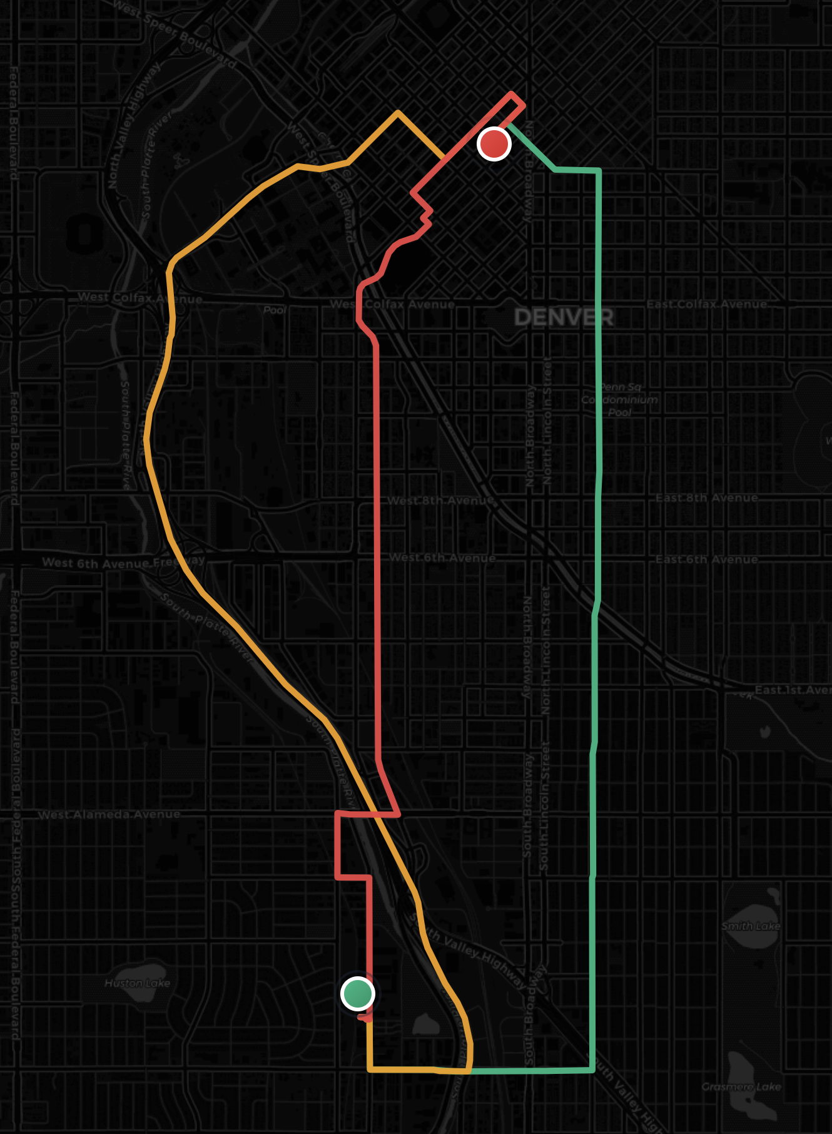
Interactive Safety Map
The UI makes safety insights visual and transparent. Users see color-coded routes and can explore the data.
Color-Coded Routes: Green (Safest) , Yellow , Red (Riskiest) .
Hover Interactions: Tooltips reveal exact risk scores, crash/hazard counts, and severity levels.

Slide 13
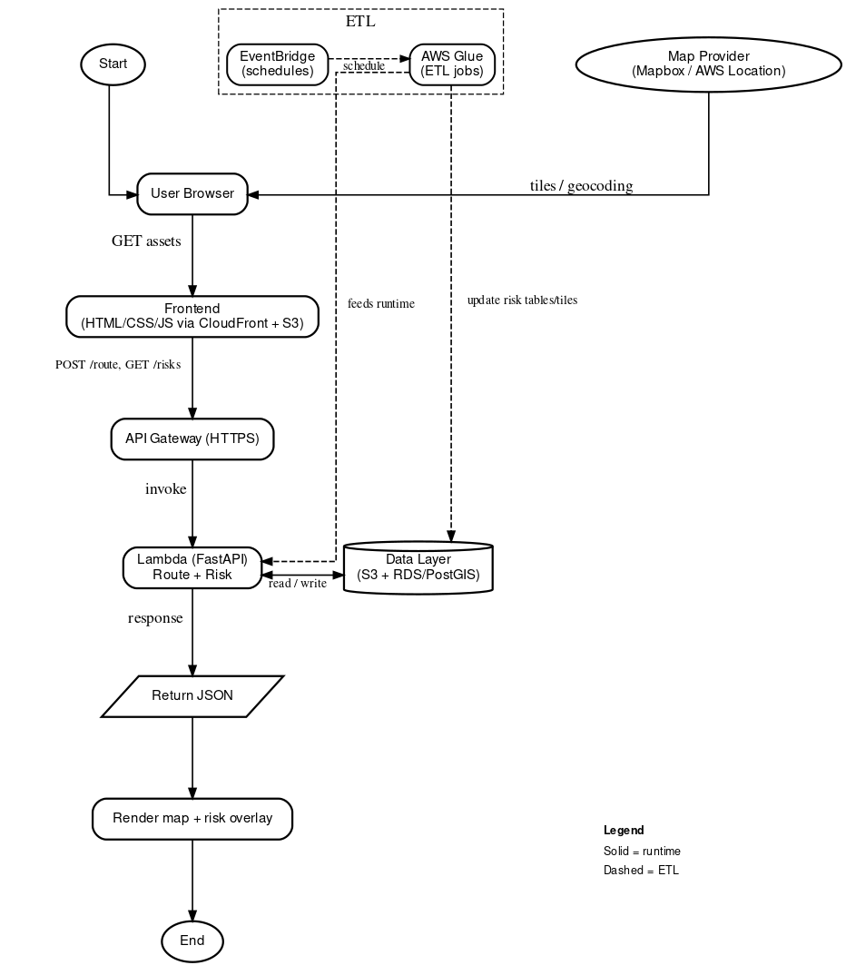
System Architecture

Slide 14
Serverless Cloud Architecture
→
→
Frontend
Backend
Database
MapLibre
FastAPI on AWS Lambda
PostGIS on AWS RDS
This architecture is fast, scalable, and cost-efficient, with S3 hosting the static frontend and API Gateway managing requests.

Slide 15
PART 05
05
Deployment & Results

Slide 16
AWS Cost-Optimized Stack
AWS provides a serverless, scalable, and free-tier friendly environment, minimizing operational costs.
AWS RDS (PostgreSQL + PostGIS)
AWS Lambda
The core spatial database.
Hosts the FastAPI backend.
AWS API Gateway
AWS S3
Exposes the public API endpoint.
Static frontend hosting)

Slide 17
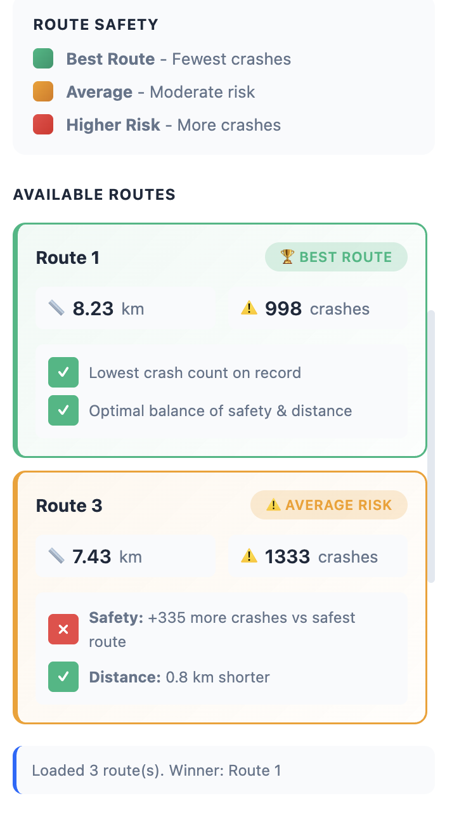
Key Empirical Findings
Our analysis reveals a critical insight: the safest route is often only slightly slower.
Time Penalty vs. Safety Gain
Safest routes are typically just 1-3 minutes slower but pass through significantly fewer crash clusters and hazards.
Traditional Engines Overlook Risk
Several "fastest" routes were revealed to be high-risk, proving Saferide's value in surfacing safer alternatives.

Slide 18
Live Demo Walkthrough
1
Enter two locations. The app requests route options from OSRM.
2
Map displays color-coded routes (Green, Yellow, Red) based on risk.
3
Hover for details: crash counts, hazard types, and risk score breakdown.
4
The "WINNER" route (Green) is highlighted as the safest option.
5
Contextual heatmaps and hazard markers justify the safety ranking.

Slide 19
PART 06
06
Next Steps

Slide 20
Overcoming Data Hurdles
Challenges
Solutions
Inconsistent raw crash data records
Variations in hazard categories and reporting
OSRM sometimes yielding similar route paths
Tuning buffer size for accurate risk capture
Built custom severity and hazard mapping logic
Implemented time-decay functions to prioritize recent events
Tuned OSRM parameters to increase route diversity
Added normalization to prevent bias towards long routes

Slide 21
Roadmap to Full Product
Short Term
Medium Term
Long Term
Add weather, construction, and lighting data.
ML crash prediction and personalized safety profiles.
Mobile app with live alerts and city planning dashboards.

Slide 22
Thank You
Thank you for reviewing Saferide. We would love to answer your questions.
Simran Jadhav
Rohan Jain

Slide 23
ＴＨＡＮＫＳ

